Slide 1

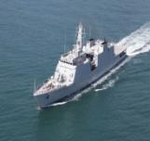
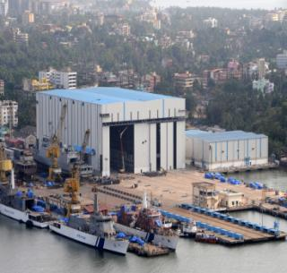
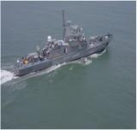
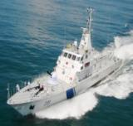
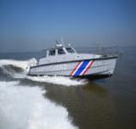
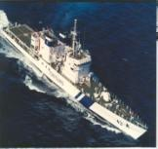
Goa Shipyard Limited
Best Performing DPSU Shipyard of MoD
Passion for Excellence

Slide 2


Introduction
Established 1957. Over 60 years of Experience in design & construction of variety of ships
GSL – One Stop Solution for shipbuilding
  Ship Design & R&D
  Construction
  After Sales Support
  Refits
Established ERP, Project monitoring System & paperless office
CRISIL Rating of long term “AAA” and short term “A1+”
Only DPSU Shipyard consistently delivering shipbuilding projects ahead of schedule

Slide 3
HISTORY OF GSL
1957
Established as “Estaleiros Navais De Goa”, by Portuguese
1967
Started functioning as “Goa Shipyard Limited” under its own Board Of Directors
1997
Upgraded to Schedule ‘B’ Company
2007
Upgraded to the status of Mini Ratna Category-1 Company

Slide 4
SHARE HOLDING PATTERN
 |  | SHARE HOLDING
 | GOVT. OF INDIA & MAZAGON DOCK LIMITED (fully owned by Govt of India) | 51.09 %
 |  | 47.21 %
 | GENERAL PUBLIC & OTHERS | 1.70 %

Slide 5
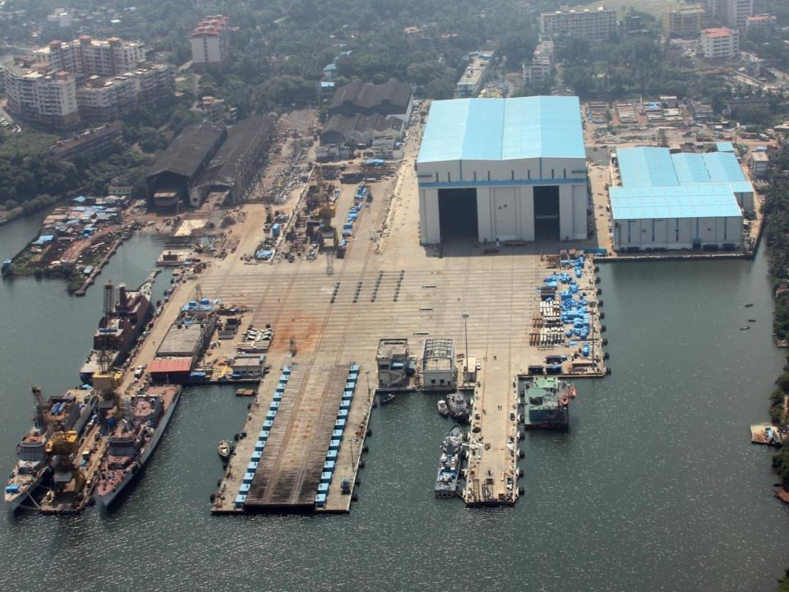
INFRASTRUCTURE

Slide 6
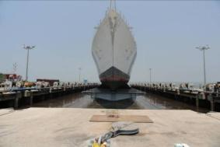
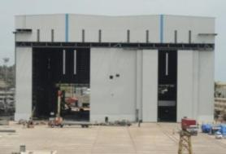
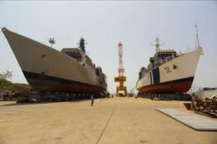
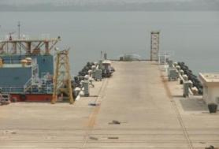
INFRASTRUCTURE
6000T Ship lift
Construction Bays
Construction Berths
Outfitting Jetties

Slide 7
Capabilities
State-of-art infrastructure for construction of vessels upto 130 m long & 23 m wide
Can undertake concurrent construction of 14 steel hulled ships at various stages
  08 at hull fabrication stage
  06 at outfitting stage
Complemented by state of the art workshops, material handling and advanced design centre
Separate outlying units for construction of FRP boats

Slide 8
HUMAN RESOURCE
Category | Total
Officers | 257
Management Trainees | 3
Supervisors | 190
Employees | 1223
TOTAL | 1673
Yard enjoys excellent Industrial Relations with the work force

Slide 9
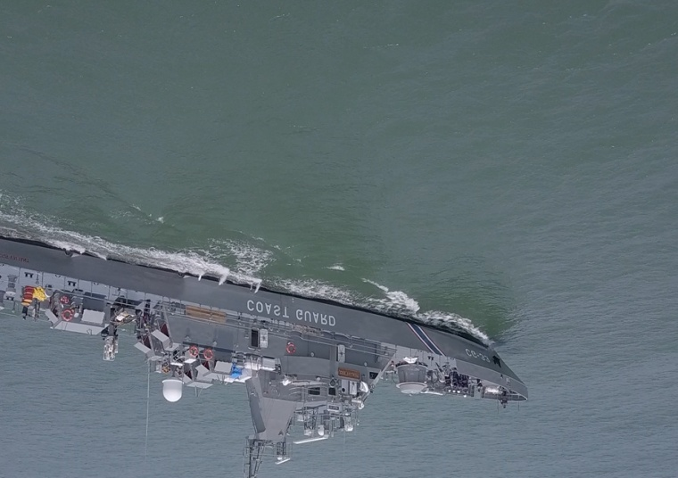
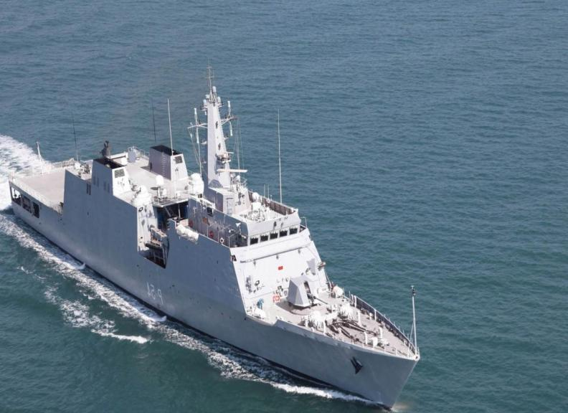
PRODUCT PROFILE

Slide 10
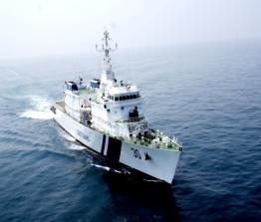
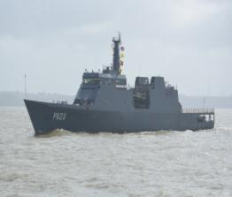
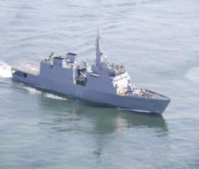
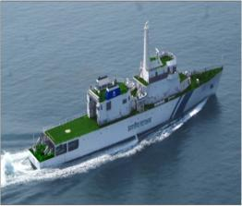
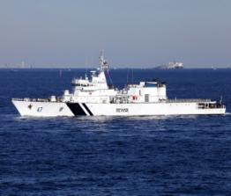

Widest Product Profile - OPVs
90m OPV
SL OPV
NOPV
CG OPV
105m AOPV
102m OPV

Slide 11

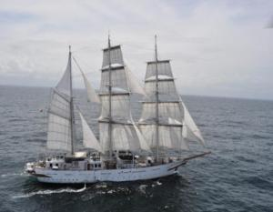
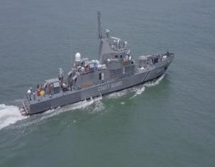
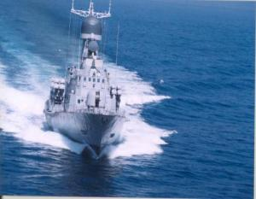

Product Profile
35 Kn FPV
STS
Mauritius FPV
Missile Crafts
Mauritius FIB

Slide 12
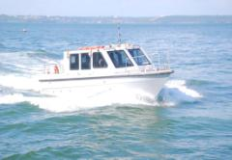
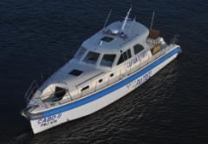
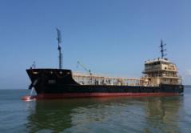
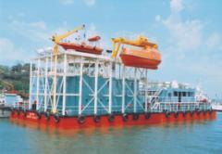
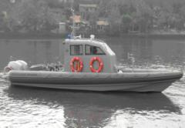
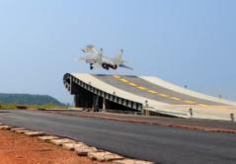
Damage Control Simulator
SMB
COP
Diversified Products
1000T Barge
Over 20% VoP from Diversified Products
SSTF
12m Boat
SBTF

Slide 13
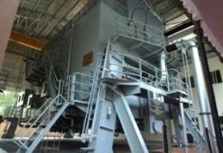
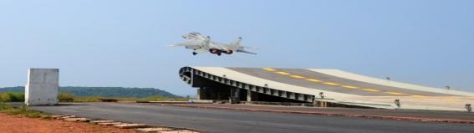
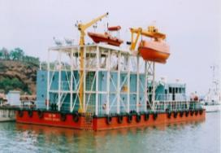
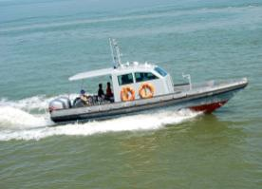
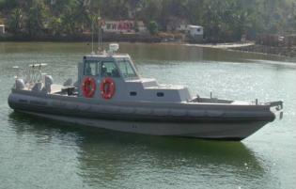

PRODUCT PROFILE - DIVERSIFICATION
DAMAGE CONTROL SIMULATOR
AIRCRAFT-CARRIER
FLIGHT DECK SIMULATOR
SURVIVAL AT SEA TRAINING FACILITY
STERN GEAR SYSTEM FOR SHIPS
5 T GRP BOATS FOR MHA
12 T GRP BOATS FOR MHA

Slide 14
PROVEN TRACK RECORD IN SHIPBUILDING
Total Deliveries as on date | 370
Naval Vessels | 66
Coast Guard Vessels | 28
Export | 36
Others | 83
High Speed FRP Interceptor Boats | 157
Only Shipyard in the country with consistent track record of delivering ships ahead of schedule

Slide 15
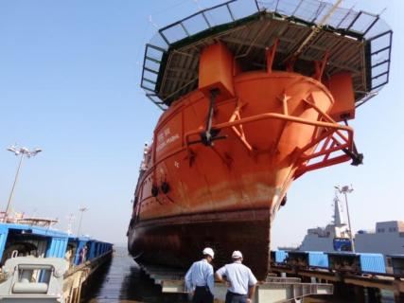
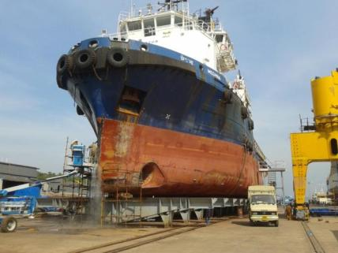
Maintenance – Ship Repairs
Massive repair infrastructure – 6000 T shiplift supported by 11 dry berths (02 covered) and 06 outfitting jetties
Comprehensive infrastructure for hull, engineering, electrical and weapon repairs
Backed by strong planning and support team for executing repairs
More than 100 vessels repaired during the last ten years

Slide 16

PERFORMANCE HIGHLIGHTS

Slide 17
Recent Track Record
2014
2015-16
2015-17
2016-17
2016-17
2017-18
2017-18
2018
01 Naval OPV
11 Interceptor Boats – Mauritius
02 Fast Patrol Vessel – Mauritius
02 Damage Control Simulator (Myanmar and IN)
02 OPVs – Sri Lanka
04 Fuel Barges (1000T)
06 Coast Guard OPVs
NBCTF – Indian Navy
All Projects (29 deliveries) in last 04 yrs, ahead of contractual delivery schedule
Fixed Cost Projects

Slide 18
Timely Delivery of All Projects : 2014 -18
Project | Customer | Actual Delivery | Delivered ahead of schedule
06 CG OPV Project | Indian Coast Guard | 30 Oct 2015 23 Mar 2016 29 Aug 2016 5 Feb 2017 7 July 2017 04 Nov 17 | 8 days 46 days 70 days 61 days 31 days 34 days
NOPV-4 | Indian Navy | 16 Jul 14 | On Schedule
1000T Fuel Barge |  | 17 Aug 17 02 Dec17 14 May 18 23 Jul 2018 | 02 days 33 days 52 days 134 days
DCS |  | 22 Mar 2017 | 112 days
1st & 2nd lot of 5 & 6 FIB | Mauritius | 07 Oct 2015 19 Jan 2016 | 90 days 51 days
FPV |  | 26 Sep 2016 30 Apr 2017 | 43 days 100 days
DCS | Myanmar | Mar 2016 | 30 days
SLN OPV Project | Sri Lanka | July 2017 Mar 18 | 86 days 25 days
29 deliveries in 04 yrs
27 ahead of schedule
02 on schedule

Slide 19
EXECUTION - SHIPS DELIVERED
Fin Year | Deliveries
2017-18 | 02 SLOPVs 02 CG OPVs 01 FPV 04 FUEL BARGES (1000T)
2016-17 | 02 CGOPVs 01 FPV 01 DCS 01 Fishing survey vessel
2015-16 | 02 CGOPVs 01 DCS 11 FIBs
2014-15 | 01 NOPV 01 SBTF
Highest amongst shipyards in India
3x
≈3 times in 3 Yrs

Slide 20


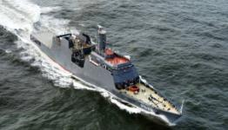

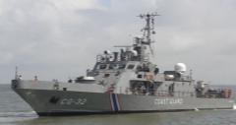
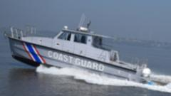


Export of Defence Products
Sri Lanka
    2 X 105 m AOPV
    (Both delivered ahead of schedule 2017-18)
Project 2014 - 18
Mauritius
    2 X 50 m, 35 Kn FAC (Delivered)
    11 Fast Interceptor Boats (Delivered)
Project 2014 –17- Completed
Myanmar
    One Damage Control Simulator
    (Delivered)
Project 2014-16 : Completed

Slide 21
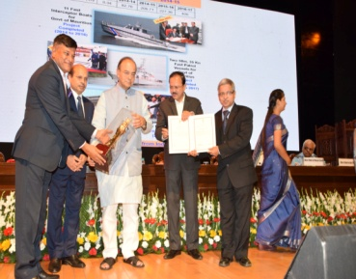
EXPORTS IN LAST 3 YEARS
30 May 17
3 times in 3 Yrs
3x
Emerged as the largest exporter of ships/vessels, with around 44% of Turnover coming from Exports.
Awarded RM’s award for ‘Best performance in Exports amongst DPSUs’ for 2014-15

Slide 22
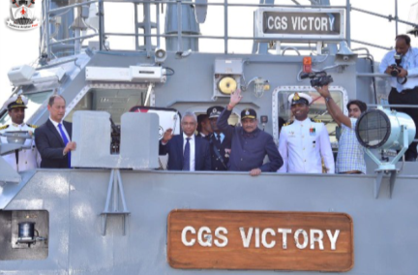
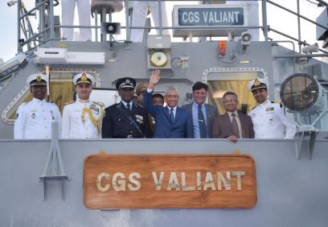
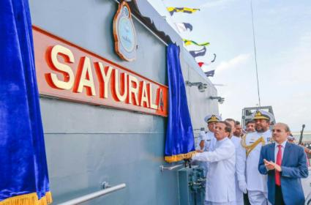
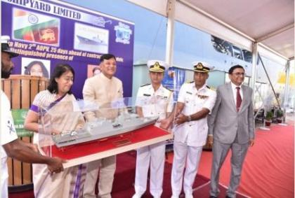
Export Accomplishments
Mauritius
16 Aug 2017
10 Dec 2016
Mauritius Prime Minister, along with Hon’ble RM commissions CGS Victory
Commissioning of CGS Victory by Hon’ble PM of Mauritius
02 Aug 2017
Sri Lanka
22 Mar 2018
Hon’ble President of Sri Lanka commissions SLNS Sayurala , in Sri Lanka Navy
Delivery by High Commissioner of Sri Lanka
SLNS Sindhurala

Slide 23
ONGOING PROJECTS
PROJECT | CONTRACTUAL DELIVERY | STATUS
New 5 CGOPVs
CGOPV 1-5 | Jan 2020 to Jun 2021 | Production commenced on 13 Nov 2016
23

Slide 24

Financial Performance

Slide 25
Financial Performance
Highest in history of GSL & 2nd amongst shipyards after MDL
x 3 times in 4 yrs
CAGR 27.4%
Value of production

Slide 26
Financial Performance - Profit
PBT CAGR 83.9%
 | FY 13-14 | FY 14-15 | FY 15-16 | FY 16-17 | FY 17-18
PBT | -63 | 53 | 111 | 177 | 331
Operating Profit | -29 | 15 | 68 | 131 | 251
Return on Equity(%) | -210% | 269% | 214% | 202% | 373%
Div Payout (% on paid up capital) | 0 | 60% | 64% | 70% | 215%
All figures in Crore Rs
-62Cr
CMD took over
01 Feb 2014

Slide 27
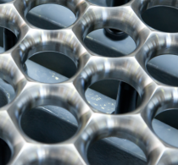
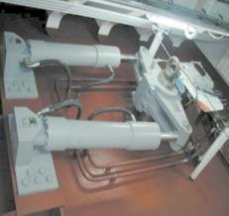
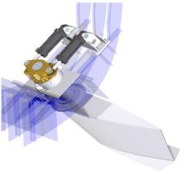

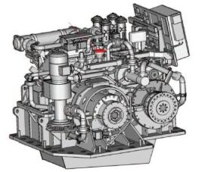
Stabilizer
Heli Grid
Steering Gear
Gear Box

Slide 28
05 CG OPV
Gearbox - Walchandnagar Industries Ltd, Pune
Heli Grid – Production by GSL in collaboration with FHS Germany
MCMV Low Magnetic DAs – Indigenised through KOEL, Pune
Steering Gear - Geeta Engg Works (GEW), Thane
Steel from Essar Steel
Gemini Boats from Aquarius Shipyard, Goa
Oily Water Separator Through Vacman in collaboration with EPE Greece
Water tight and Weather tight Doors from ACGL, Goa & Zuari Engg Services
Other Projects
Recent Initiatives - ‘Make In India’

Slide 29
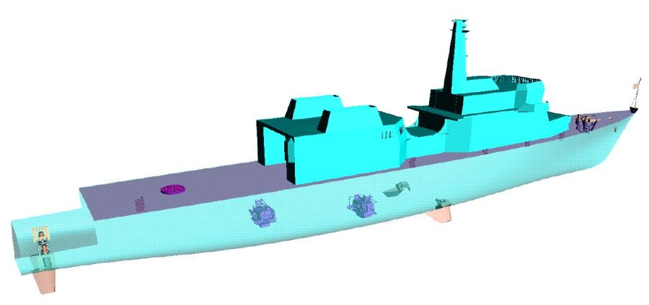
GSL’s Indigenization Efforts
Ongoing 05 CG OPV Project
Heli Grid
Steering Gear
Fin Stabiliser
Gear Box
Major critical equipment indigenised for ongoing 05 CG OPV Project
Indigenous content increased from 60% to 70%

Slide 30

Multiple Collaborations with World Leaders In Line with ‘Make In India’ Initiative of Govt of India

Slide 31
COLLABORATIONS SIGNED UP WITH WORLD LEADERS FOR ‘MAKE IN INDIA’
Griffon Hover Works Ltd, UK
Indigenous manufacture of Fin Stabilizers.
Nevskoe Design Bureau Russia
DAMEN Shipyards, Gorinchem
Naval Group, France
Wartsila France SAS
MTU 8000 series Engines
Mine Counter Measure Systems
Shore Based Test Facility (SBTF) for Training / certification of Naval Combat Aircraft Pilots
Hovercrafts
NAIAD, UK
Submarine Escape Training Tower (SETT)
Integrated Platform Management System
CPP Stern Gears
Combat Management System
Pollution Control Vessels (PCVs)
MTU, Germany
Thales DMS France
07 to 10 MW capacity

Slide 32
Indigenous Manufacturing under ‘Make In India’
Hovercrafts
Model I - Recce & Patrol
Model II - Troop Carrier
Indigenous manufacture with 60% local content, in partnership with Wartsila France SAS
Successfully supplied / supplying stern gear for multiple projects
CPP Stern Gears
Combat Management System (CMS)
Partnership with Naval Group
Scorpene Submarine Simulators
Utilised for Training / certification of Naval Pilots
Shore Based Test Facility (SBTF)
Partnership with NDB, Russia
Integrated Platform Management System (IPMS)
Submarine Escape Training Tower (SETT)
Partnership with Griffon, UK for indigenous prod with 60% local content

Slide 33
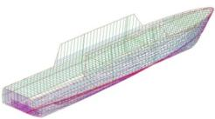

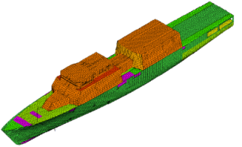
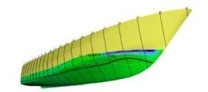
115 m Platform
RESEARCH & DEVELOPMENT
World class R&D centre with AVEVA Marine & state of art Softwares for modeling with in-house design capability
Strong domain expertise in design & construction of Naval Surface Vessels including OPVs & FACs
Expertise in FORAN being developed for 1135.6 Ships
1st shipyard in India to be recognised by Dept of Scientific & Industrial Research (DSIR), Ministry of Science & Technology

Slide 34
Modernised Shipyard
Transfer Area
Shiplift
Outfitting Jetty
Ship Assembly Workshop
Shipyard Modernisation

Slide 35


Infrastructure Modernisation
Modern Shipbuilding infrastructure created at ≈ ₹ 750 Cr
  Ship lift & transfer system
  Ship Assembly Bays
  Dry berths & jetties
  FRP Construction facilities
₹ 400 Cr CAPEX WIP with EDC –mid 2020
Phase 4 – ₹ 167 Cr
Phase 3B – ₹ 286 Cr
Steel workshop
GRP Complex
Transfer system for GRP ships
Block Assembly shop
60 T LL Crane
Phase 3A Inaugurated by Hon’ble PM on 13TH Nov 2016

Slide 36

Future Projects - Import Substitute
MCMV
Technology Advanced Future Projects
Make in India
1135.6 Frigates
Hovercrafts

Slide 37


AIR CUSHION VEHICLES (HOVERCRAFT)
RECCE & PATROLLING
TROOP CARRIER
  Joint production with M/s Griffon, UK - 60% indigenisation content in line with Buy Indian (IDDM) requirements
  Actively participating in ongoing acquisition case by ICG for 12 ACVs

Slide 38
MOU RATING WITH GOVT
FIN YEAR | RATING
2011-12, 2012-13 & 2013-14 | GOOD
2014-15 | VERY GOOD
2015-16 | EXCELLENT
2016-17 | EXCELLENT WITH 100% MARKS FOR 02 CONSECUTIVE YEARS A UNIQUE DISTINCTION BY ANY DPSU
2017-18

Slide 39

BEST PERFORMING Mod ShipayrD: fy 15-16

Slide 40




11 Apr 2017
SCOPE INSTITUTIONAL CATEGORY AWARD
FINANCIAL TURNAROUND 2014-15
Conferred on 11 Apr 2017
Recognitions and Awards
Best Performing Shipyard
2015-16
Design efforts
2014-15
Best Performance in Exports
2014-15
RM Excellence Award conferred on 30 May 2017

Slide 41







Goa Shipyard Limited
Passion for Excellence
FY17 Dividend @70%
FY18 Dividend @ 215%
THANK YOU

