Slide 1
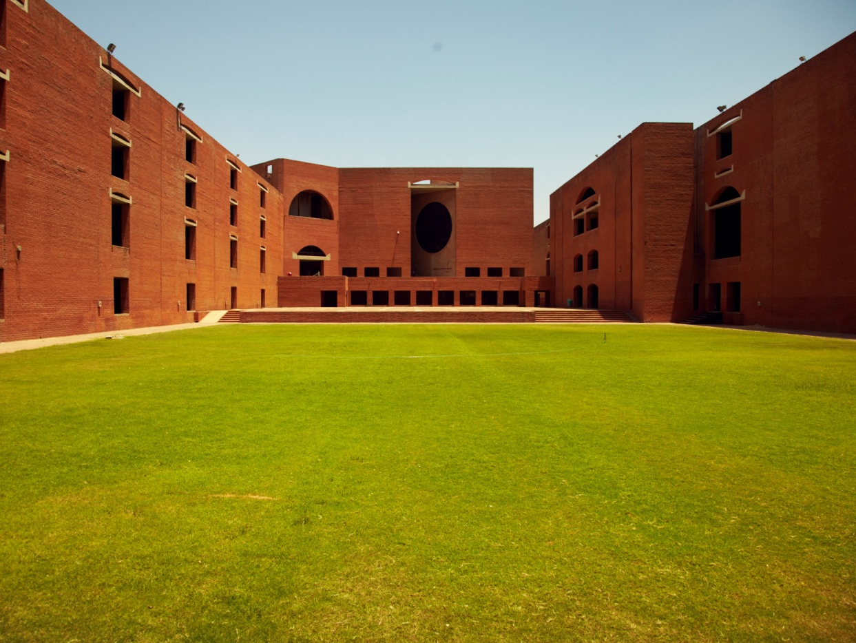
Indian Institute of Management
Ahmedabad

Slide 2
e-Procure @ IIMA
IIM Ahmedabad (Brief Introduction to the Campus)
Experience sharing on e-Procurement
Q/A

Slide 3
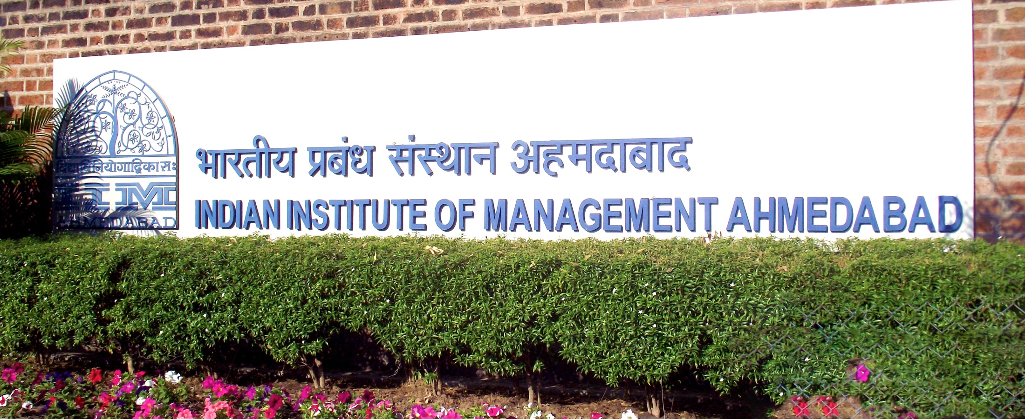
About IIMA
Established on December 11, 1961
As a Society which has 100+ members
Collaboration between :
- Central Government
- State Government
- Local Industries &
- Ford Foundations
Governed by Board of Governors which has 15 members
Chairman of Board & Society : Shri Kumar Mangalam Birla (Chairman Aditya Birla Group)

Slide 4
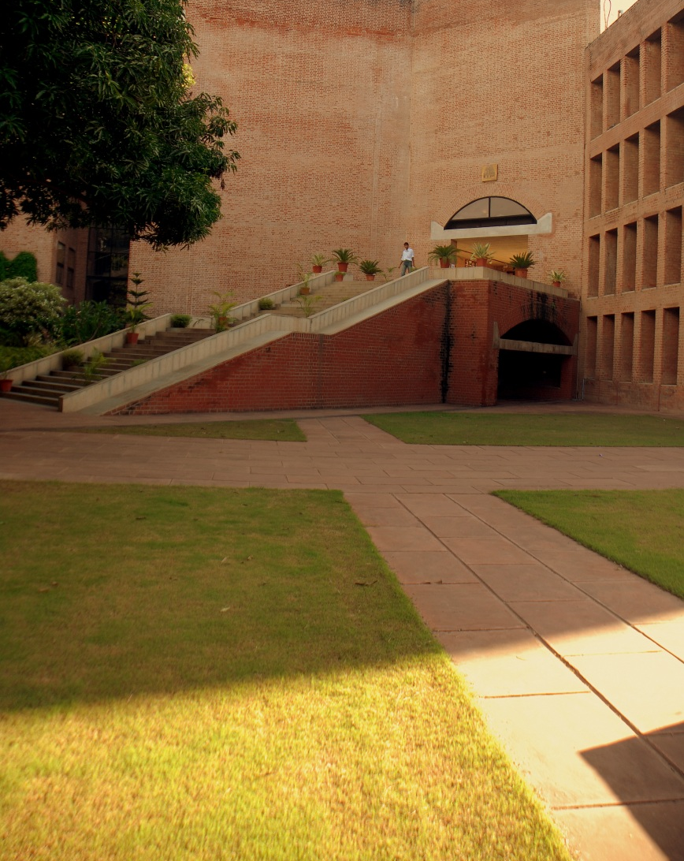
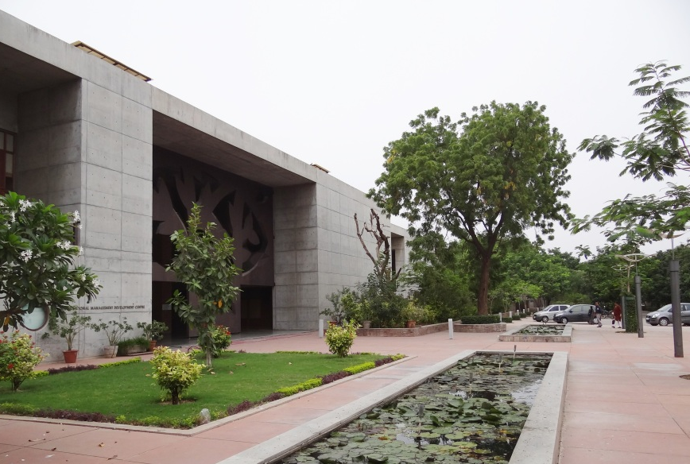
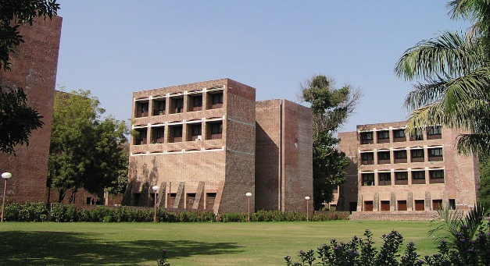
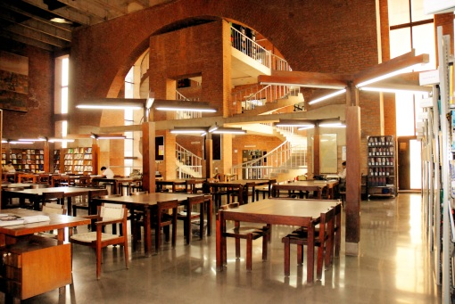
Land & Buildings
Land Area – 103 Acres [Heritage Campus (64 Acre) & New Campus (39 Acre)]
Built Space – 1.7 million Sq.Ft
Classrooms / Seminar rooms – Main Campus (11)
- - New Campus (14)
Library – 48,000 Sq.Ft
Dorms - 33 Dorms – 1050 rooms
Dining hall – 500 capacity
Married Student Houses (MSH) - 120 Nos.
IMDC, KLMDC & Annxe for PGP-X & Executive Education
Programmes – 300 rooms
Auditorium - 575 Seating Capacity
Indoor and Outdoor Sports Facilities
Houses for faculty and staff – 287 Nos.

Slide 5
IIMA Administration-Organization Chart
Board of Governors
Projects & Maintenance
Campus Management Services
Director
Chief Administrative Officer
House Keeping
Dispatch
Security
Facilities
Landscape & Garden Upkeep
Transport
Stores & Purchase
HR & legal
Establishment
Secretarial
Welfare
Hindi
Medical
Finance & Budget
Civil & Structural
Electrical
HVAC
Water Supply
Contracts & Compliance

Slide 6
Procurement @ IIMA
Procurement of Goods (Capital/Revenue items)
Procurement of Services
Procurement for Turnkey Projects
Procurement activities are carried out as per GFR guidelines

Slide 7
e-Procurement @ IIMA
Manual Tendering | E-Tendering
Long Procurement Cycle | Short Procurement Cycle
Expensive | Cost Effective
Manual Comparison/Analysis | Automated Comparison/Analysis
Restricted Mobility | Any Time / Any Where
No work on Holidays | Any Time
Prone to Human Errors | Less chance of Errors
Physical Security, Difficult to retrieve information | Full Proof Security with easy retrieval as and when required
IIMA decided to begin journey of e-procurement on eprocure.gov.in in 2016-2017

Slide 8
e-Procurement @ IIMA
https://eprocure.gov.in/
Decentralization of tendering activities within organization
Transparent Process with hassle free compliance management
Enhanced Efficiency with savings on cost of Paper, Postage, Time

Slide 9
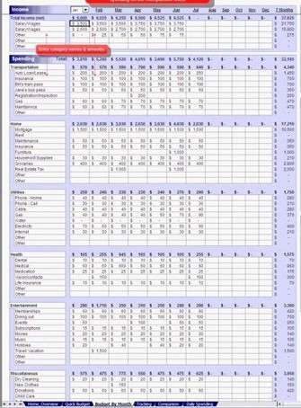
e-Procurement @ IIMA
https://eprocure.gov.in/
Easy to use BOQ Templates facilitating automated Price Bid Analysis even in complex scenarios (ItemRate, ItemWise, ItemGroup, BuyBack etc.)

Slide 10
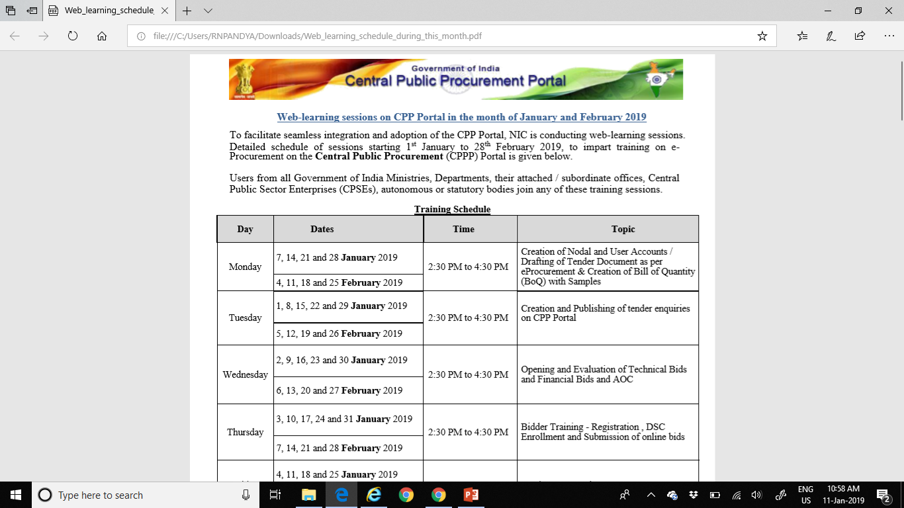
e-Procurement @ IIMA
https://eprocure.gov.in/
Well organized WEB based training sessions by NIC
Support from NIC at each and every stage was Wonderful and very effective

Slide 11
e-Procurement @ IIMA
Summary Statistics and Future Plan
Tenders Published on eprocure.gov.in
Year | Nos | Value (Lakhs)
2016-2017 | 11 | 724
2017-2018 | 161 | 2998
2018-2019 | 126 | 61054
Reverse Auction feature on eprocure.gov.in to be used

Slide 12
e-Procurement @ IIMA
A big thank you for making the journey on eprocure.gov.in very smooth and successful
to
NIC Team

