Slide 1
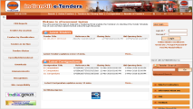
e-Procurement @ IOCL
GEPNIC by NIC

Slide 2
Table of Contents
Objectives & Our Journey
Critical success factors
Successful portal adoption
Functional benefits
Performance benefits
Green benefits
Awards and Recognition

Slide 3
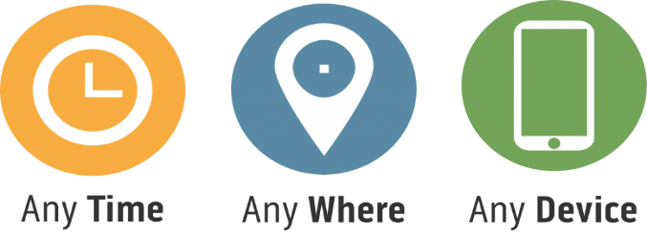
Transparency
Objectives
Equal Opportunity
Global Participation
Security & Compliance
Robust Mechanism
Paperless Participation

Slide 4
e-Tendering : Our journey
Online EMD
First Tender
November 2015
Reverse Auction
May 2011
Process Manual
October 2017
Help-Desk Setup
June 2016
NDA Based &
Two-Stage Tenders
June 2011
755 bids received in single tender
December 2018
August 2014
2010
2011
2012
2013
2014
2015
2016
2017
2018
2019
All Major Locations covered
1090 bids received in single tender
Seamless bid opening done in couple of minutes
January 2018
December 2012
Item-wise Technical Evaluation
August 2016

Slide 5
Critical Success Factors
Collective Wisdom
Release
Management
Collaboration
with NIC
Support
Infrastructure
Continuous
Training
Operational Manual
Process Manual

Slide 6
Successful Portal Adoption
Tenders Published
Tendering Officials
Registered Bidders
Tender’s are being processed from around 1000 locations of IOCL through NIC e-Tendering Portal.
Some key indicators of successful adoption of e-Tendering portal at IOCL are as shown below:

Slide 7
Online EMD Payment & Refund
Tender Creation
Online EMD
Net Banking, RTGS/NEFT
Forfeit EMD
Bid Submission
Rejected
Bids
Technical Bid Opening
Techno-Commercial Evaluation
Yes
Rejected
Bids
Forfeit EMD?
Financial Bid Opening
Financial Evaluation
No
Automatic EMD Refund
Rejected Bids
Award of Contract

Slide 8
Functional Benefits
Smooth EMD Payment & Refund
Reduction in complaints and litigation
Enhanced Bidder’s confidence in online and secure bidding process
Availability & Sharing of Tender Documents across IndianOil
Completely Digital Process
Report Management
Enhanced Bid Participation
Better price discoveries
IOCL e-Tendering Portal

Slide 9
Increased Bidder Participation
Performance Benefits

Slide 10
Reduction in Procurement Lead time
Performance Benefits

Slide 11
Paperless Process
Trees Saved
Prevented CO2 release
Green Benefits

Slide 12
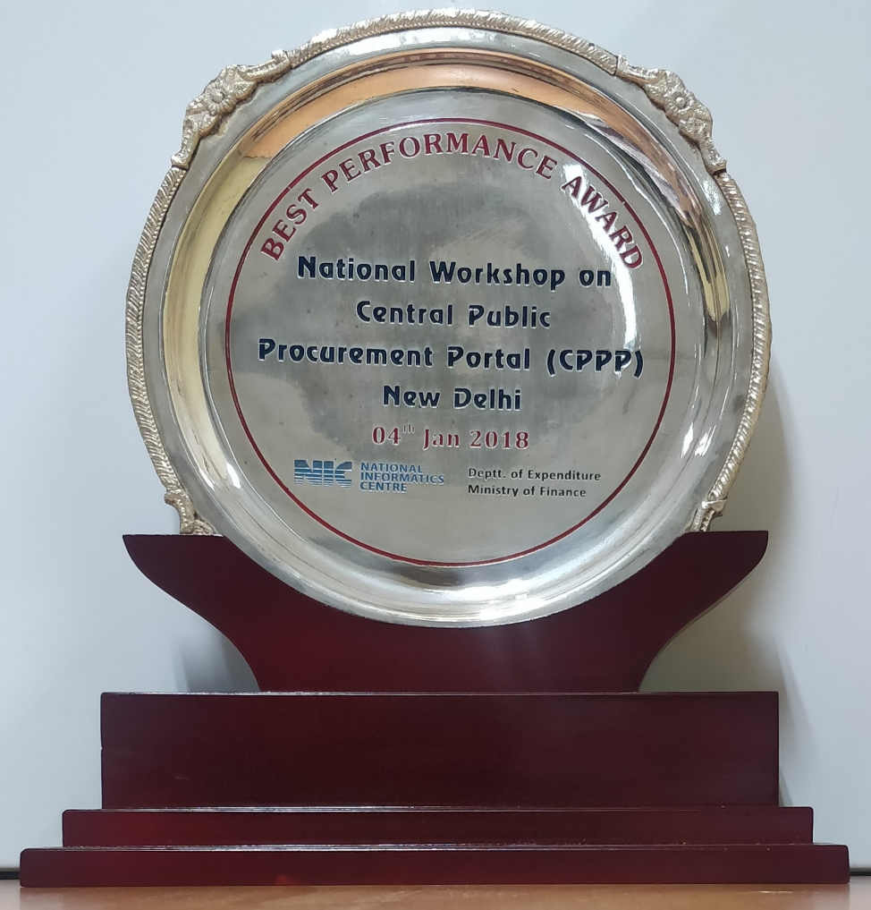
Awards and Recognition
e-GOV award for e-Procurement solution, July 2013
Best Performer Award in e-Tendering
Dept. of Expenditure (Ministry of Finance),
MeitY and NIC, January 2018.

